Slide 1
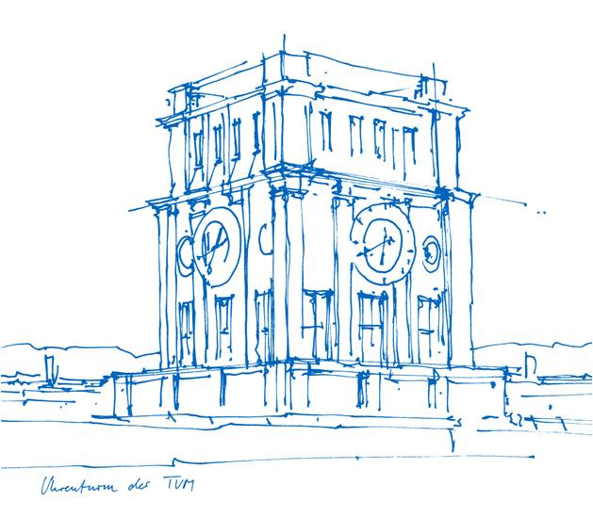
MSBRDM Project: Welding Robot
You-Ri Su, Pablo Eusse Martinez, Jose Antonio Botello Vazquez, Tobias Töws
Technische Universität München
Chair of Cognitive Systems
TUM School of Computation, Information and Technology

Slide 2
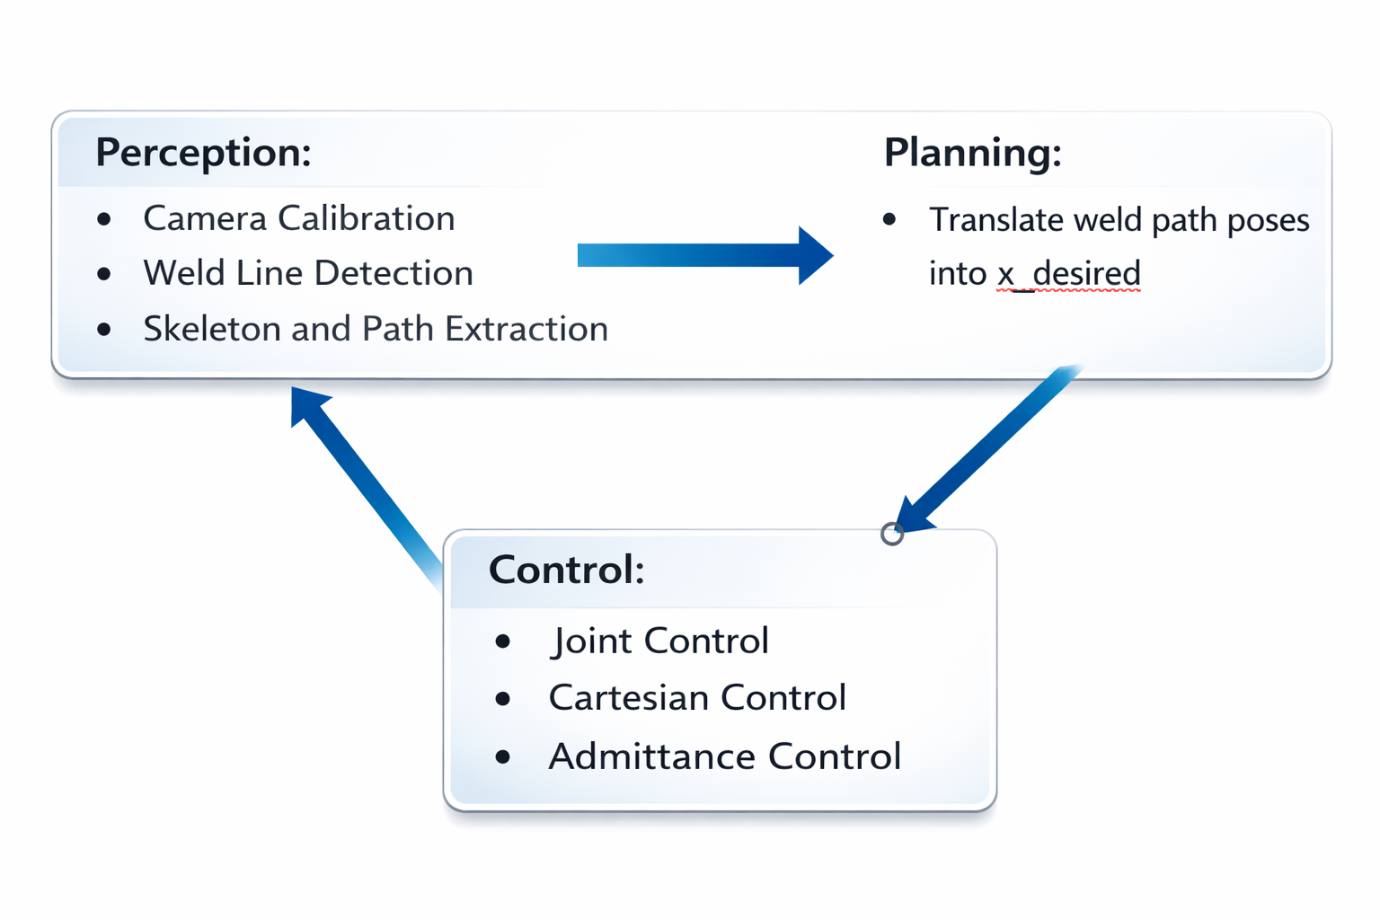
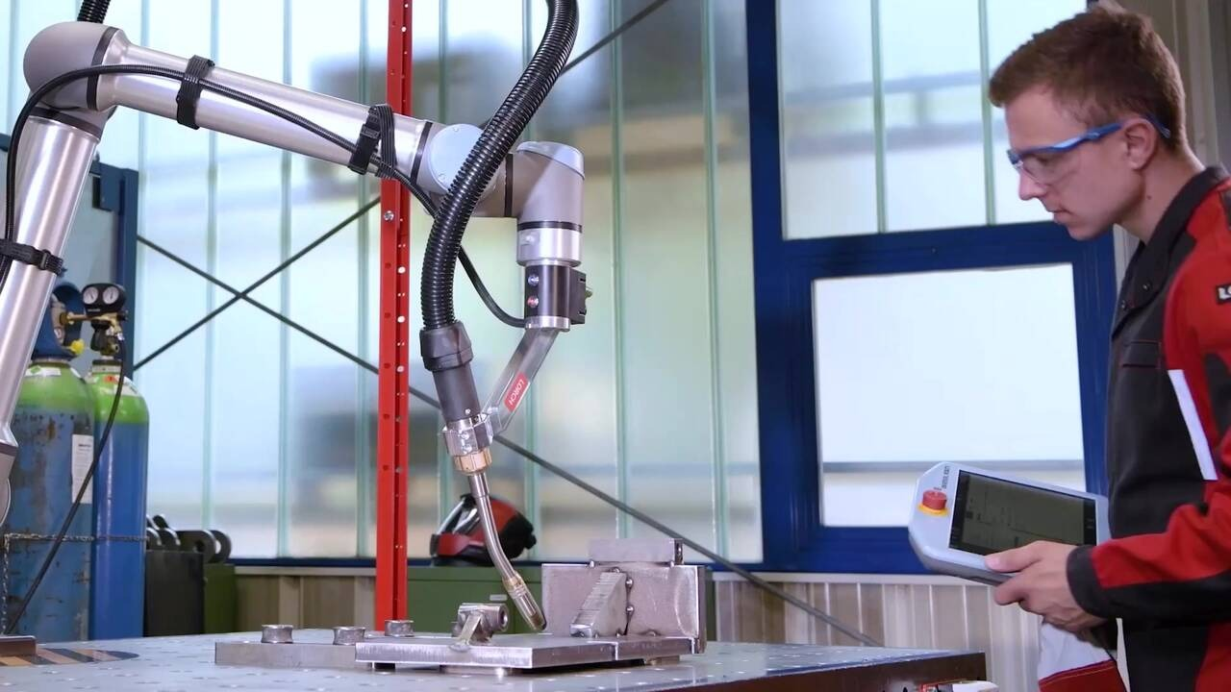
Project Description
Task and Approach
Challenge:
Perceiving the trajectory (extracting, smoothing)
Positioning workspace and trajectory
Maintaining orientation
Applying constant force to the workpiece (table)
Following the perceived trajectory
Approach:

Slide 3
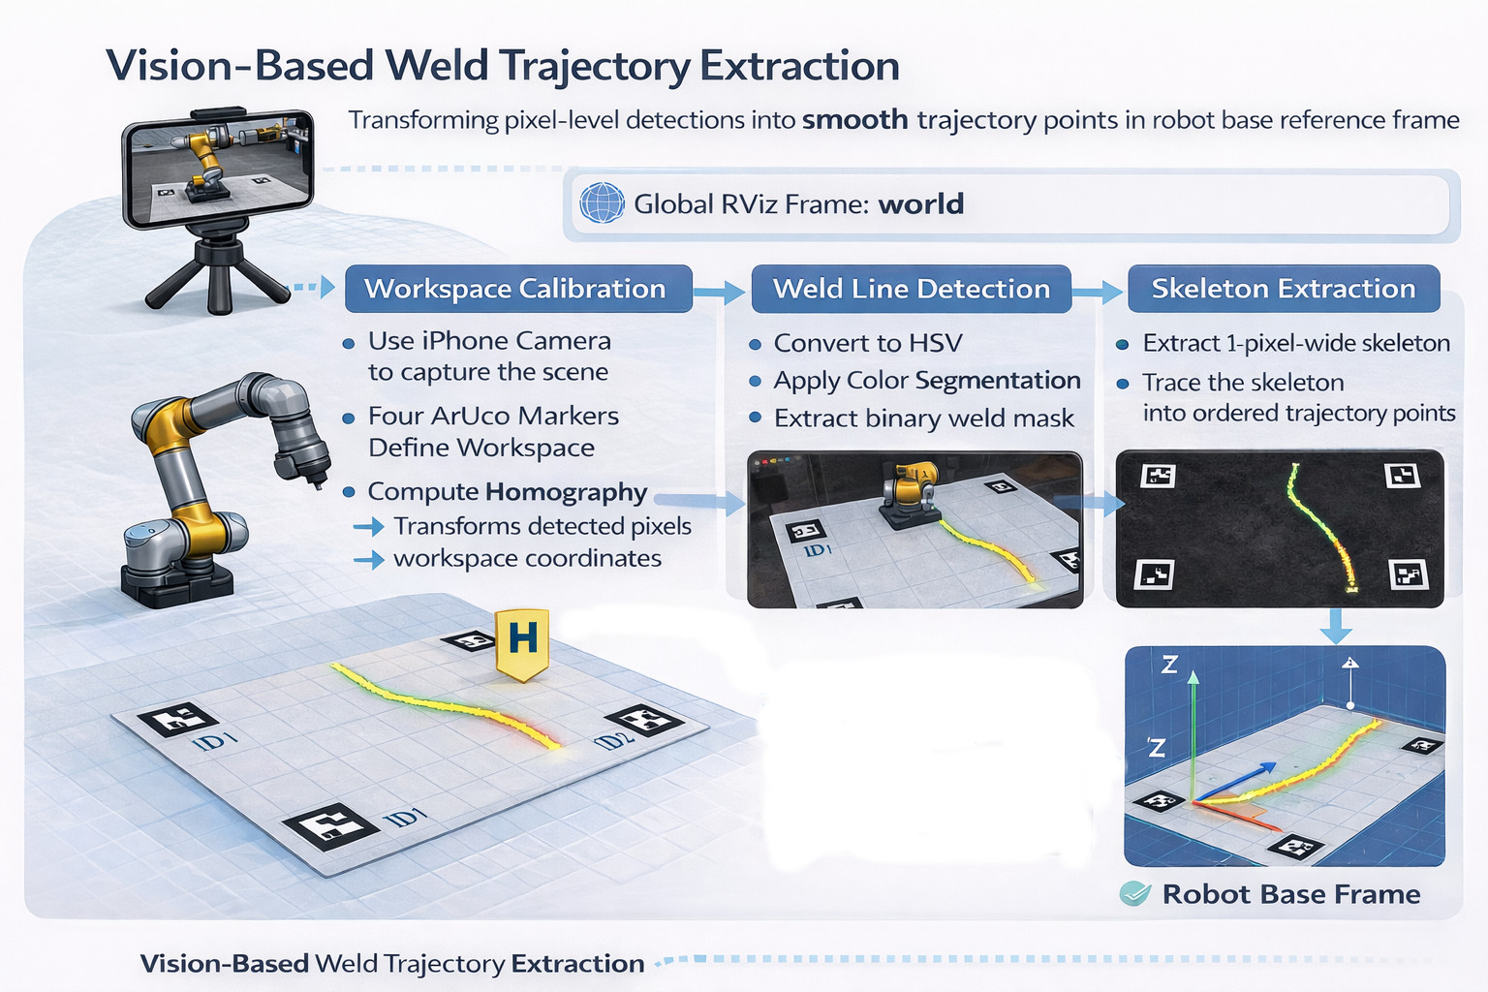
Perception Module
Detecting the trajectory

Slide 4
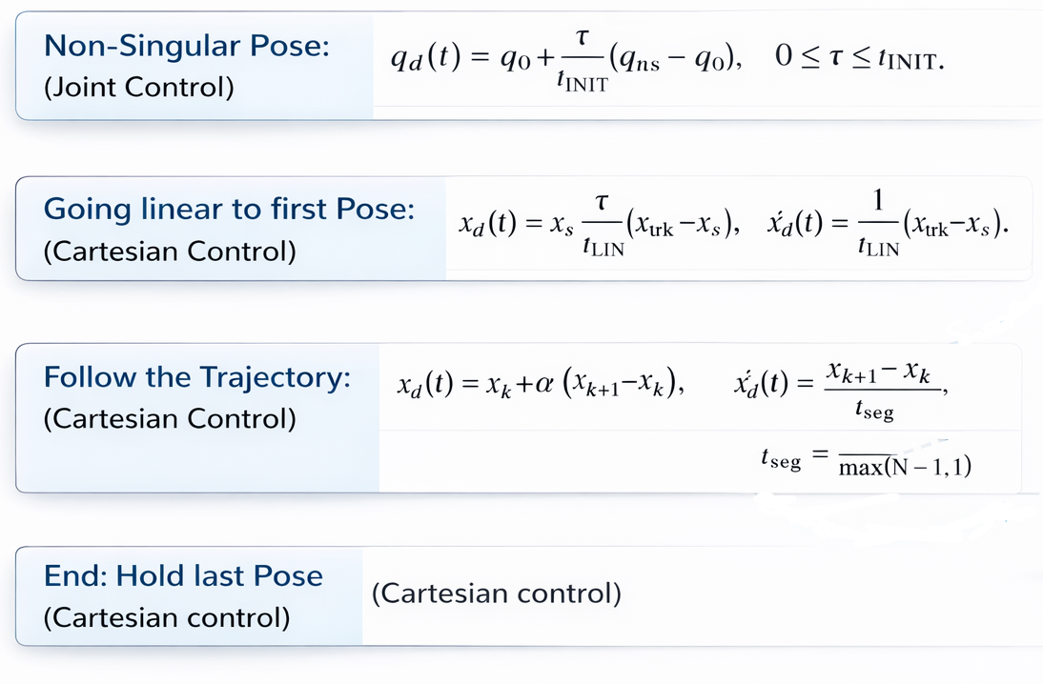

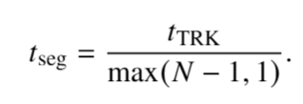


Trajectory Generation
Notes:
t_seg = time per pose, k = index of current pose, alpha = iteration variable for interpolation => interpolate between each pose, xd_dot = use constant velocity between poses,

Slide 5
Admittance Controller
Model End Effector as a mass in a gravitation field.
Avoids excessive force coming from displacement of spring system.
We had to adjust to sensor noise by taking the absolute value of the z-axis forces

Slide 6


Joint Controller
PD Joint Controller with regularization:

Slide 7
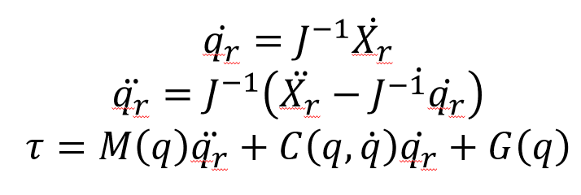
Cartesian Controller
Use the first three columns of the translational jacobian for references in joint space.

Slide 8
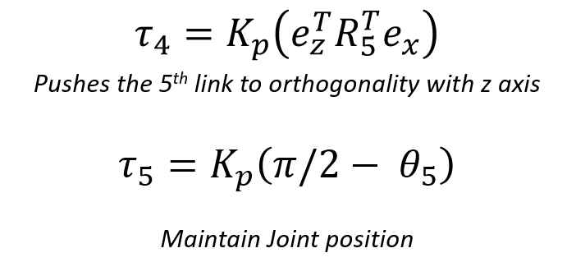
Orientation Controller

Slide 9

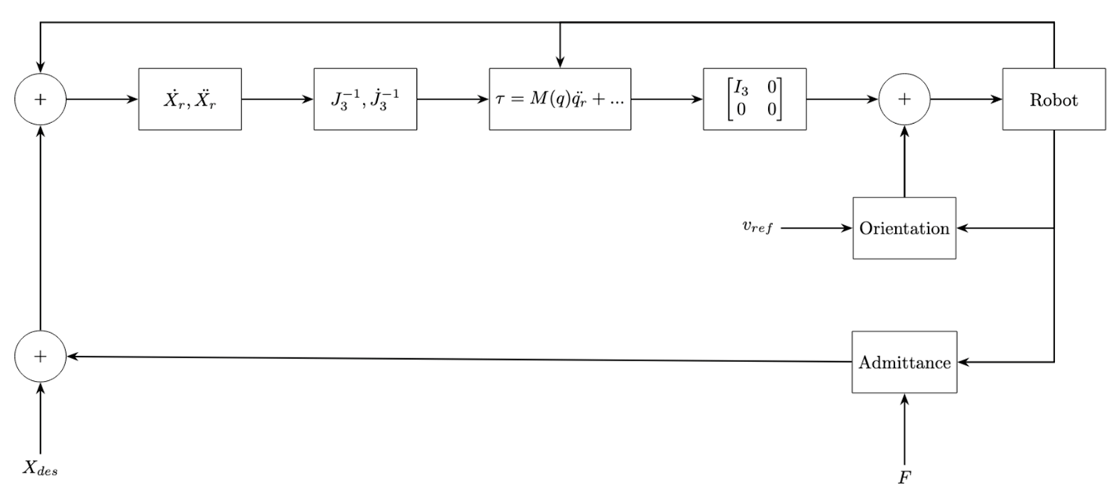
Controller Structure

Slide 10
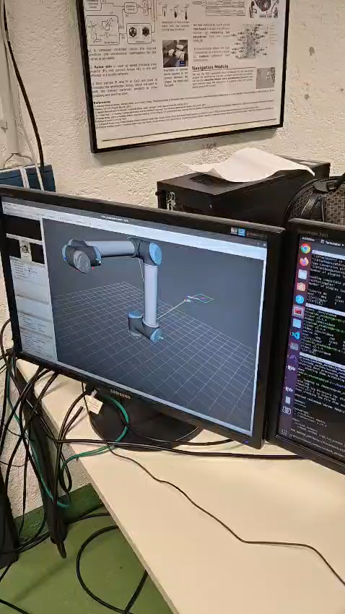
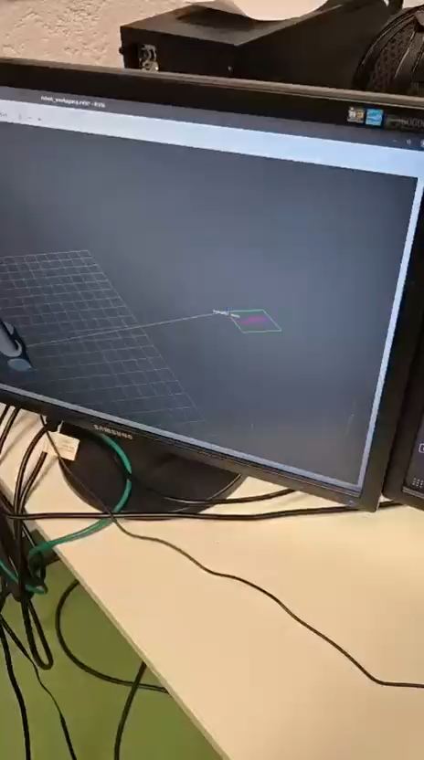
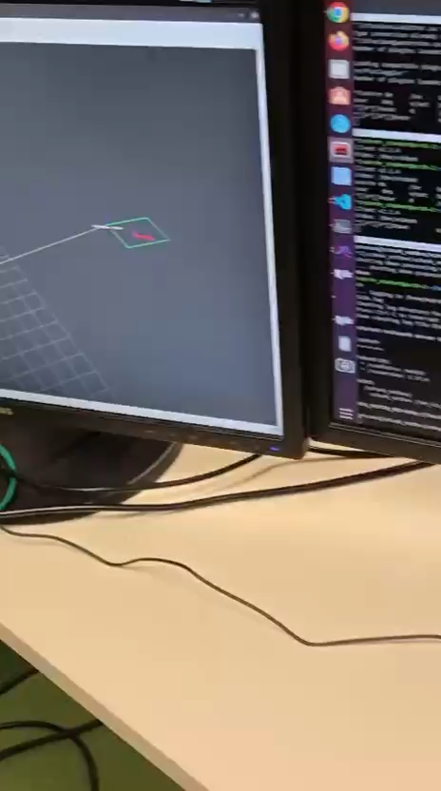
Videos
Simple line
Curves

Slide 11
Results
Perception:
Trajectory tracking inside the workspace using a phone camera
Estimation of Camera-to-World and World-to-Workspace transformations (not actively used)
Planning:
Joint control to reach a non-singular configuration, followed by linear motion to the first waypoint, then interpolation between each perceived pose
Control:
All controllers operate relatively stably
Orientation control achieved by using the first four joints to control the X- and Y-axes, while using joint 5 to keep the end-effector orientation constant and keeping joint 6 fixed with a 90° offset relative to joint 5
Z-axis control implemented using an admittance controller

Slide 12
Troubleshooting
Perception:
The trajectory is detected in pixel space and must be smoothed; the centerline is then used as the trajectory
Camera quality and lighting conditions affect trajectory detection → improved through camera intrinsic calibration and color tuning
A defined workspace is used to filter out irrelevant detections and publish only valid trajectory data
Camera quality also affects positioning of the robot base and workspace → therefore, the robot base is hard-coded relative to the workspace
Planning:
Alignment of the perceived workspace with the hard-coded robot base on the controller side to obtain the intended trajectory direction and position
Conflict between Z-direction trajectory and controller force (downward force control) → only X and Y trajectory components are used
Control:
Gain tuning: Too low Gains, lead to non smooth State Transitions
Admittance controller: Added a Gravity term and no Spring component, as this lead to a crashing into the workpiece

Slide 13
Thank you! :)

Slide 14
Appendix: Focused part
You-Ri Su:
Vision
Planning
Jose Antonio Botello Vazquez:
Vision
Pablo Eusse Martinez:
Planning
Control
Tobias Töws:
Planning
Control
Everyone:
Integration and testing of all modules
Report
Presentation

